Slide 1






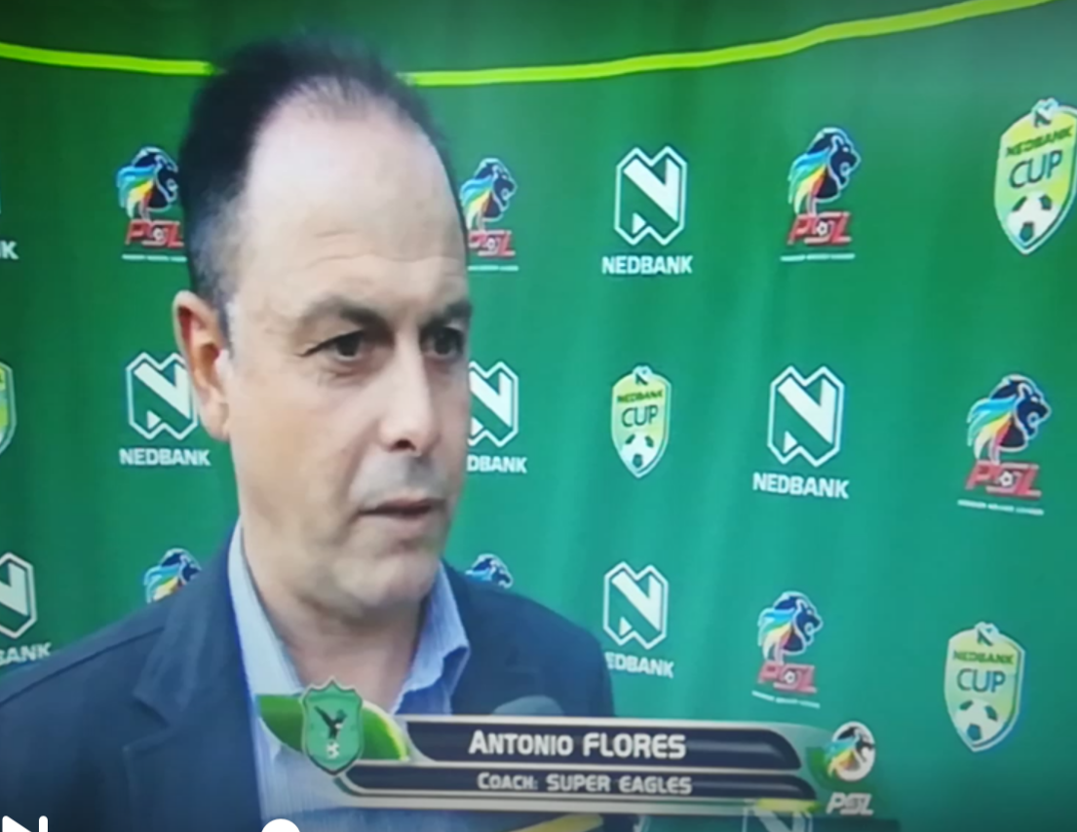







COACH ANTONIO FLORES
-vast experience -worked under 5 national federations -5 african clubes
-psl/nfd in sa -best record winning in lesotho premier 78.3%
-former staff coach in la liga /ud almeria/

Slide 2
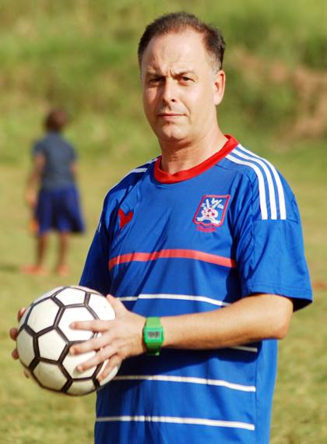
STRONG POINTS
-UNDERSTANDING- FILOSOPHY OF SC VILLA,COMPLETE KNOWLEDGE OF THE CLUB
-UGANDA FOOTBALL AND PLAYERS,FANS SUPPORTERS AND VILLA FAMILY
-MORE EXPERIENCED IN AFRICAN FOOTBALL
-KNOWER OF PAST MISTAKES AND THE WAY TO TAKE
-GREAT NET CREATED IN AFRICA ,SA,SPAIN
-WISHED FOR PLAYERS TO BE COACHED UNDER ME
-A MASTER IN COACHING SESSIONS
-HIGHER COACHING DEGREE THAN COACHES THERE
-METODOLOGY AS SPAIN APPLIED FOR AFRICAN PLAYERS
-ANTONIO FLORES BECOME A CURRENT STRONG AFRICAN MANAGER

Slide 3
TARGETS TO GET-WORK
-MAKE A GREAT SQUAD MIXED VETERAN/YOUNGSSTARS
-CREATE A PROFFESIONAL LINE IN TRAINING WORKING,METODOLOGY AS SPAIN-SA
-DEVELOP THE TECNICAL-TACTICAL-FISICAL TO COMPETE IN HIGHEST LEVEL
-UNDER A PHILOSOPHY INTEGRAL FOOTBALL-DOMINATION IN ALL FOOTBALL FASES
-TO COMPETE FOR ALL TROPHIES AND GET
-CREATE A LINE WITH SPAIN AND SA TO COLABORATE IN PLAYERS,SPONSORS,PROMOTION
-OPEN A SCOUTING DEPARTMENT TO TAKE THE YOUNG BEST PLAYERS IN THE COUNTRY
-UNDER 15 ,UNDER 17,HIGH DEVELOPMENT UNDER SAME METODOLOGY THAN SENIOR
-INTERNATIONAL TOURNAMENTS FOR YOUTH TEAMS TO PROMOTE PLAYERS,CLUB,LINKS

